Slide 1

Enhancing Customer Engagement and Revenue Growth Strategic Insights and Recommendations Presented by: Wissmon Germain Date: January 30, 2025
ONLINE RETAIL PRESENTATION

Slide 2
Agenda
Introduction
Business Challenge and Goals
Understanding Our Customers
Market and Sales Trends
Understanding Customer Value
Final tips & takeaways

Slide 3

Business Challenge and Goals

Slide 4
The Problem
Our recent marketing campaign achieved only a 3% response rate, well below the expected 6%.

Slide 5
Why This Matters
This low response rate suggests inefficiencies in targeting and customer engagement, leading to wasted resources

Slide 6
Our Objective
Improve marketing strategies to increase customer engagement and maximize revenue growth.

Slide 7
Understanding Our Customers

Slide 8
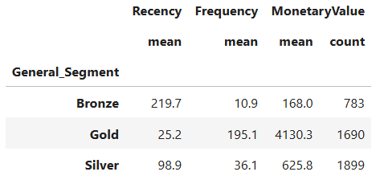
Customer Purchasing Behavior
Some customers buy frequently and generate high revenue.
Others shop infrequently but spend a lot when they do.
Some customers rarely purchase and contribute minimal revenue

Slide 9
Market and Sales Trends

Slide 10
Sales Overview
Number of Customers | Quantity of items sold | Amount of Sales | Number of Item types sold | Number of Countries
4,372 | 4,908,888 | $8,300,066 | 3,896 | 37
Some customers buy frequently and generate high revenue.
Others shop infrequently but spend a lot when they do.
Some customers rarely purchase and contribute minimal revenue

Slide 11
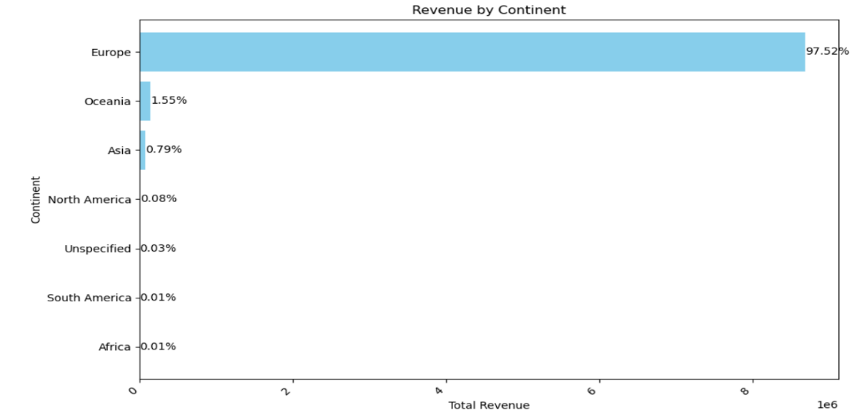
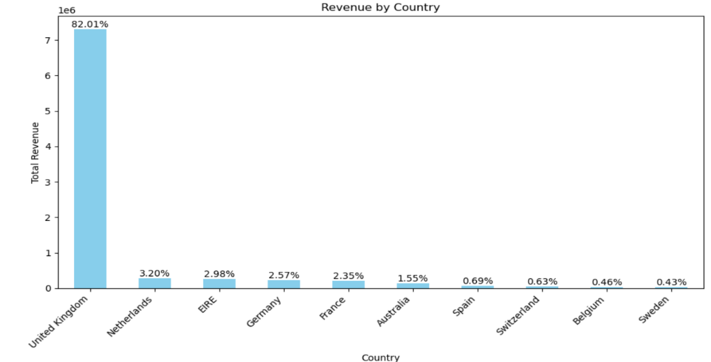
Where Do Our Sales Come From?
97.5% of revenue comes from Europe, with the UK alone contributing 82%.

Slide 12
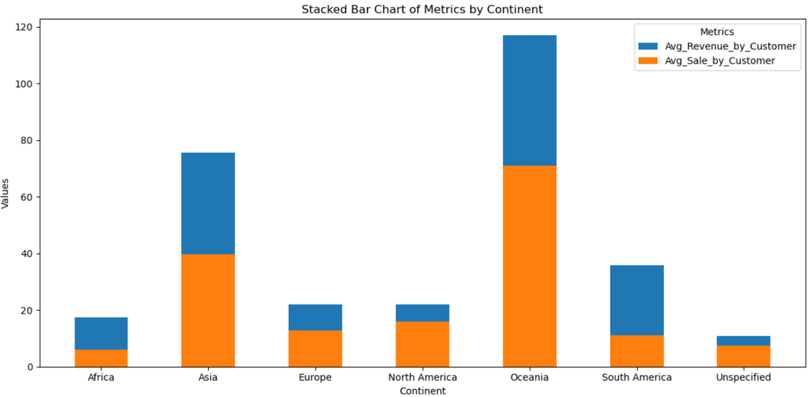
Customers in Oceania and Asia spend more per purchase, making them promising expansion markets.

Slide 13
Where Do Our Sales Come From?
97.5% of revenue comes from Europe, with the UK alone contributing 82%.

Slide 14
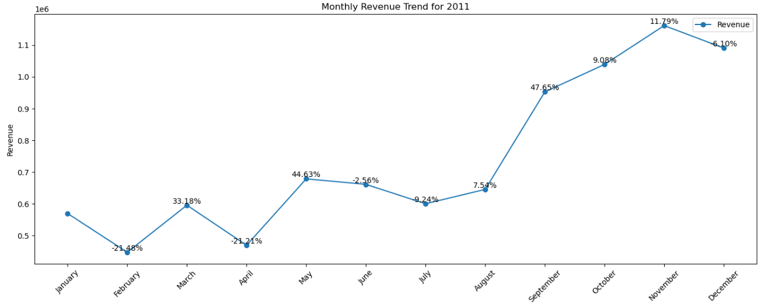
Seasonal Trends
Revenue peaks in November, showing a strong holiday shopping influence

Slide 15
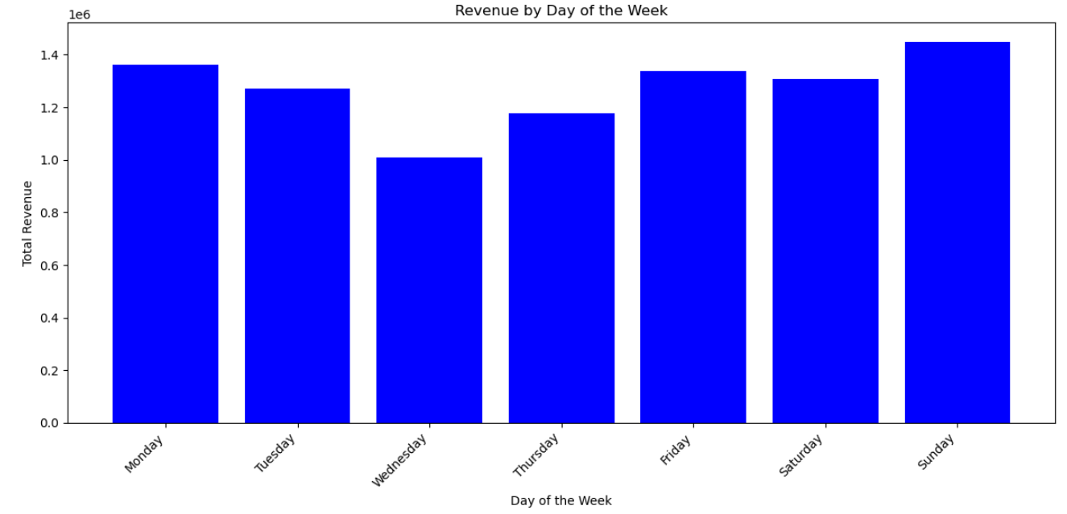
Seasonal Trends
Sales are highest on Sundays, lowest on Wednesdays

Slide 16
Understanding Customer Value

Slide 17
Understanding Customer Value
Not all customers contribute equally to revenue.
We identified four types of customers:
Top Value Customers: Spend frequently and generate the highest revenue.
High-Value Customers: Make large purchases but less frequently.
Medium-Value Customers: Have moderate spending patterns.
Low-Value Customers: Shop infrequently and generate minimal revenue.

Slide 18
Key Business Recommendations
Smarter Targeting in Marketing:
Focus on Top and High-Value Customers for personalized offers.
Develop loyalty programs to increase retention.
Expanding High-Spend Markets:
Increase marketing efforts in Oceania and Asia.
Test regional promotions to measure engagement.
Product and Customer Satisfaction Improvements:
Address high return rates for top-selling products.
Enhance customer service for repeat buyers..

Slide 19
Looking Ahead
Next Steps:
Implement targeted campaigns for high-value customers.
Explore new market strategies for Oceania and Asia.
Improve product quality to reduce returns.
Final Thought: Small changes in customer engagement strategy can lead to big revenue improvements.

Slide 20

Selecting visual aids
Q&A
Open for discussion.
Thank you!

